Slide 1
Data Structures and Algorithms (ESO207)
Lecture 23
Finding a sink in a directed graph
Graph Traversal
Breadth First Search Traversal and its simple applications

Slide 2
An interesting problem
(Finding a sink)
Definition: A vertex x in a given directed graph is said to be a sink if
There is no edge emanating from (leaving) x
Every other vertex has an edge into x.
sink
How many sinks can there be in G ?
At most 1.

Slide 3
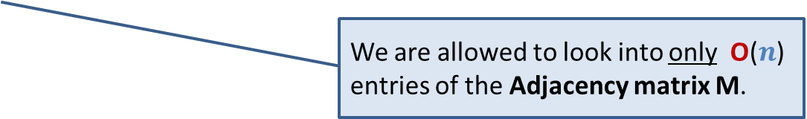
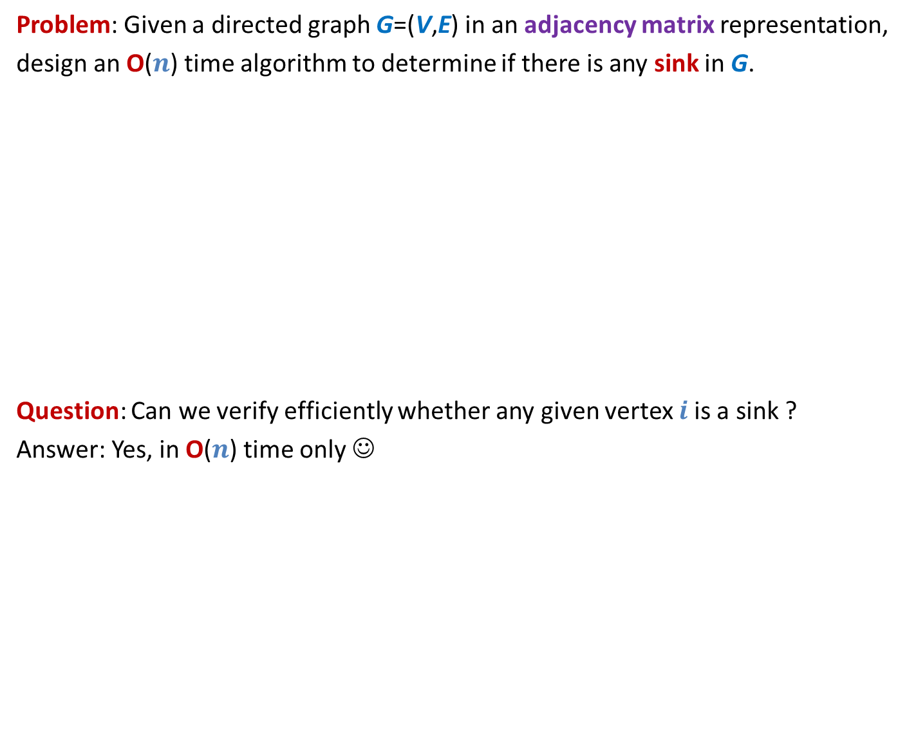

An interesting problem
(Finding a sink)
Problem: Given a directed graph G=(V,E) in an adjacency matrix representation,
design an O($n$) time algorithm to determine if there is any sink in G.
Question: Can we verify efficiently whether any given vertex $i$is a sink ?
Answer: Yes, in O($n$) time only ☺
We are allowed to look into only O($n$) entries of the Adjacency matrix M.
Sink
Look at $i$th row and $i$th column of M.

Slide 4






Key idea
If M[$i,j$] = 0, then ??
If M[$i,j$] = 1 , then ??
$$j$$
Can we eliminate $n−1$non-sink vertices in O($n$) look-up into the Adjacency Matrix M ?
M
$$i$$
$j$ can not be sink
$i$ can not be sink

Slide 5
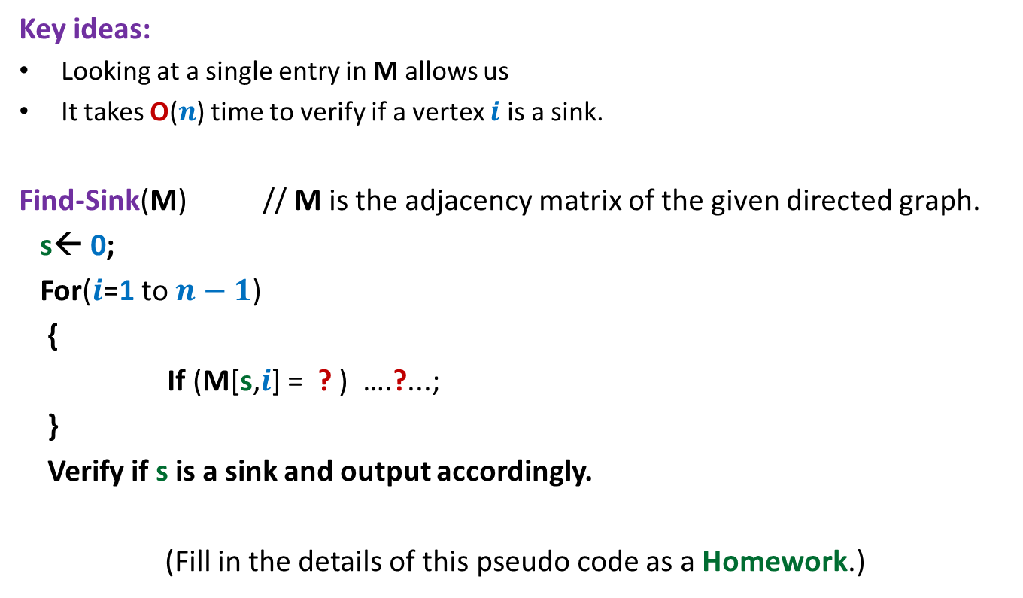
Algorithm to find a sink in a graph
Key ideas:
Looking at a single entry in M allows us
It takes O($n$) time to verify if a vertex $i$ is a sink.
Find-Sink(M) // M is the adjacency matrix of the given directed graph.
s← 0;
For($i$=1 to $n−1$)
{
If (M[s,$i$] = ? ) ….?...;
}
Verify if s is a sink and output accordingly.
(Fill in the details of this pseudo code as a Homework.)
to discard one vertex from being a sink.

Slide 6
What is Graph traversal ?

Slide 7
Graph traversal
Definition:
A vertex y is said to be reachable from x
Graph traversal from vertex x:
Starting from a given vertex x, the aim is
to visit all vertices which are reachable from x.
if there is a path from x to y.
x
y

Slide 8
Non-triviality of graph traversal
Avoiding loop:
How to avoid visiting a vertex multiple times ?
(keeping track of vertices already visited)
Finite number of steps :
The traversal must stop in finite number of steps.
Completeness :
We must visit all vertices reachable from the start vertex x.

Slide 9
Breadth First Search traversal
We shall introduce this traversal technique through an interesting problem.
computing distances from a vertex.

Slide 10
Notations and Observations
Length of a path:
the number of edges on the path.
x
y
A path of length 6 between x and y

Slide 11




Notations and Observations
Observation:
If <$x$, …,$v\text{,} y$> is a path of length $k$ from $x$ to $y$,
then what is the length of the path <$x$, …,$v$> ?
Answer: $k−1$
Question: What can be the maximum length of any path in a graph ?
Answer: $n−1$
$$k$$
x
$$v$$
y
$$k−1$$

Slide 12
Notations and Observations
Shortest Path from x to y:
Distance from x to y:
A path from x to y of least length
the length of the shortest path from x to y.
x
y

Slide 13
Shortest Paths in Undirected Graphs
Problem:
How to compute distance to all vertices reachable from x in a given undirected graph ?
x
b
w
f
u
h
v
d
g
r
y
s
c

Slide 14


Shortest Paths in Undirected Graphs
$V_{0}$ : Vertices at distance 0 from x: ??
$V_{1}$: Vertices at distance 1 from x: ??
$V_{2}$: Vertices at distance 2 from x: ??
x
b
{x}
w
f
u
{f,u,b}
h
v
d
{g,h,s,r,v,w}
g
r
y
Why ?
s
c
While reporting $V_{2}$, you have (sub)consciously used an important property of shortest paths.
Can you state this property ?

Slide 15

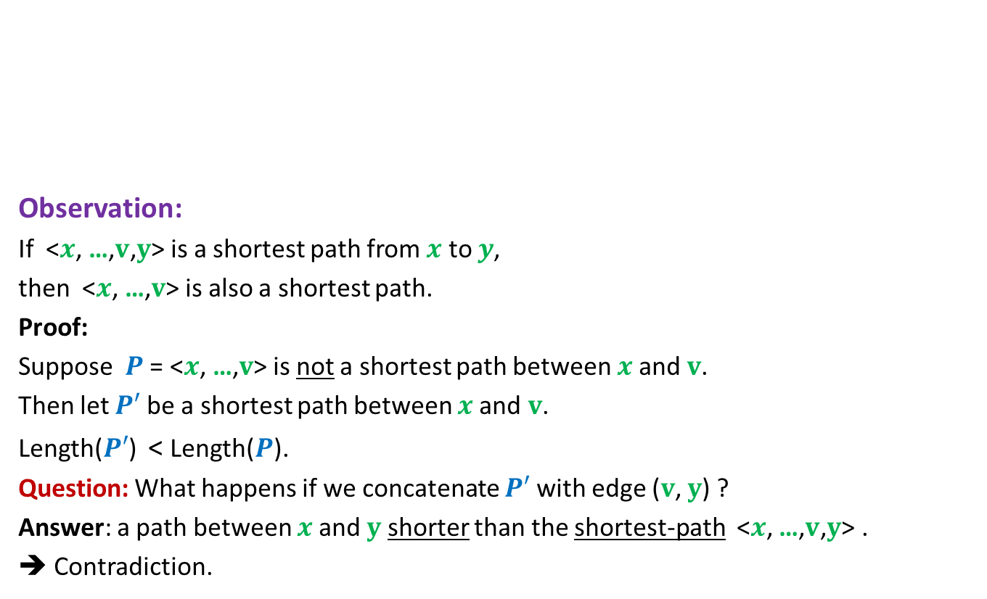


An important property of shortest paths
$$P′$$
Observation:
If <$x$, …,$v\text{,} y$> is a shortest path from $x$ to $y$,
then <$x$, …,$v$> is also a shortest path.
Proof:
Suppose $P$ = <$x$, …,$v$> is not a shortest path between $x$and $v$.
Then let $P′$ be a shortest path between $x$and $v$.
Length($P′$) < Length($P$).
Question: What happens if we concatenate $P′$ with edge ($v$, $y$) ?
Answer: a path between $x$and $y$ shorter than the shortest-path <$x$, …,$v\text{,} y$> .
➔ Contradiction.
A shortest path
between x and y
x
v
y
What can you say about $P$ ?
$$P$$

Slide 16








An important question
Question:
Let ($v$,$w$) be an edge. If Distance($x$,$v$) is $k$,
then what can be Distance($x$,$w$) ?
Answer: an element from the set {$k−1$, $k$, $k+1$} only.
$$w$$
$$w$$
$$w$$
A shortest path
between x and v
x
$$k$$
v
$$k−1$$
$$k$$
$$k+1$$

Slide 17




Relationship among vertices at different distances from x
$V_{0}$ : Vertices at distance 0 from x = {x}
$V_{1}$ : Vertices at distance 1 from x =
Neighbors of $V_{0}$
$V_{2}$ : Vertices at distance 2 from x =
Those Neighbors of $V_{1}$ which …
.
.
.
$V_{i+1}$ : Vertices at distance i+1 from x =
Those Neighbors of $V_{i}$ which …
do not belong to $V_{0}$ or $V_{1}$
do not belong to $V_{i}−1$ or $V_{i}$
How to distinguish the neighbors of $V_{i}$ which belong to $V_{i+1}$ from those which belong to $V_{j}$, $j$≤ $i$ ?

Slide 18
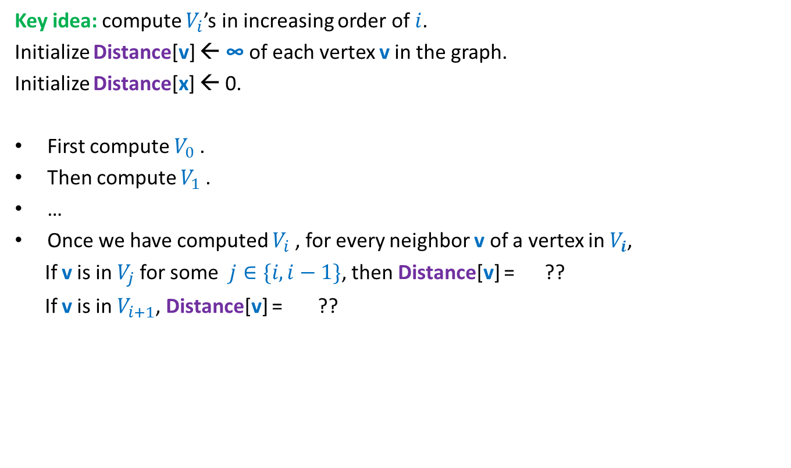

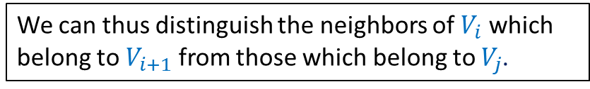

How can we compute $V_{i+1}$ ?
Key idea: compute $V_{i}$’s in increasing order of $i$.
Initialize Distance[v] ← ∞ of each vertex v in the graph.
Initialize Distance[x] ← 0.
First compute $V_{0}$.
Then compute $V_{1}$.
…
Once we have computed $V_{i}$, for every neighbor v of a vertex in $V_{i}$,
If v is in $V_{j}$for some $j∈\{i,i−1\}$, then Distance[v] = ??
If v is in $V_{i+1}$, Distance[v] = ??
a number ≤ $i$
∞
We can thus distinguish the neighbors of $V_{i}$ which belong to $V_{i+1}$ from those which belong to $V_{j}$.

Slide 19
A neat algorithm for computing distances from x
we need an algorithm which traverses/visits the vertices in
non-decreasing order of distances from x
This traversal algorithm is called BFS (breadth first search) traversal

Slide 20



Using a queue for traversing vertices in non-decreasing order of distances
Compute distance of vertices from x:
x
b
x
$$V_{0}$$
w
f
u
f u b
$$V_{1}$$
h
v
d
u b g h
g
r
y
b g h s r v w
s
c
Remove x and for each neighbor of x that was unvisited, mark it visited and put it into queue.
g h s r v w
$$V_{2}$$
Remove f and for each neighbor of f that was unvisited, mark it visited and put it into queue.
Remove u and for each neighbor of u that was unvisited, mark it visited and put it into queue.
Remove b and for each neighbor of b that was unvisited, mark it visited and put it into queue.

Slide 21
BFS traversal from a vertex
BFS(G, x)
CreateEmptyQueue(Q);
Distance(x) ← 0;
Enqueue(x,Q);
While( ?? )
{ v ←Dequeue(Q);
For each neighbor w of v
{
if (Distance(w) = ∞)
{ Distance(w) ← ?? ;
?? ;
}
}
}
Not IsEmptyQueue(Q)
Distance(v) +1
Enqueue(w, Q);

Slide 22
Running time of BFS traversal
BFS(G, x)
CreateEmptyQueue(Q);
Distance(x) ← 0;
Enqueue(x,Q);
While( ?? )
{ v ←Dequeue(Q);
For each neighbor w of v
{
if (Distance(w) = ∞)
{ Distance(w) ← ?? ;
?? ;
}
}
}
Running time of BFS(x) = no. of edges in the connected component of x.
A vertex can enter queue
at most once.
Prove this claim first.
Not IsEmptyQueue(Q)
Distance(v) +1
O(deg(v))
Enqueue(w, Q);

Slide 23
Correctness of BFS traversal
Question: What do we mean by correctness of BFS traversal from vertex x ?
Answer:
All vertices reachable from x get visited.
Vertices get visited in the
At the end of the algorithm,
Distance(v) is the distance of vertex v from x.
non-decreasing order of their distances from x.
We shall discuss this proof in the next lecture. Please think over it for some time before next lecture.

